Slide 1
Training of Micro Observers
Lok Sabha Election 2024
Venue: District Library Auditorium
Darrang
Date: 5th April 2024

Slide 2
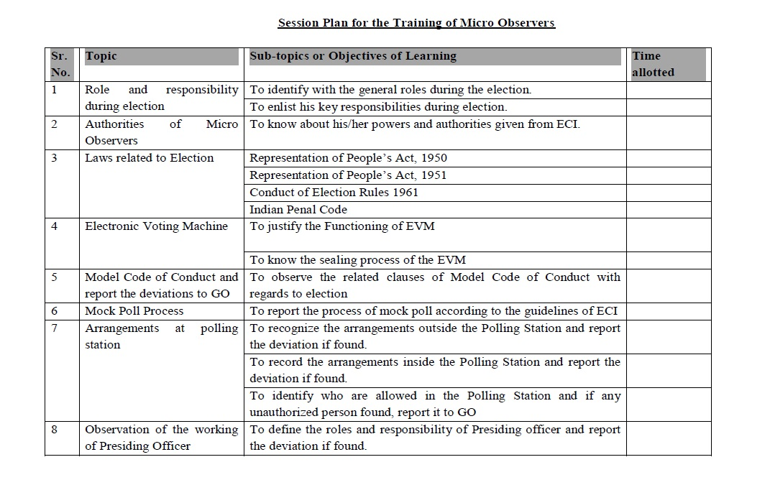
Session Plan for the training of Micro Observers

Slide 3
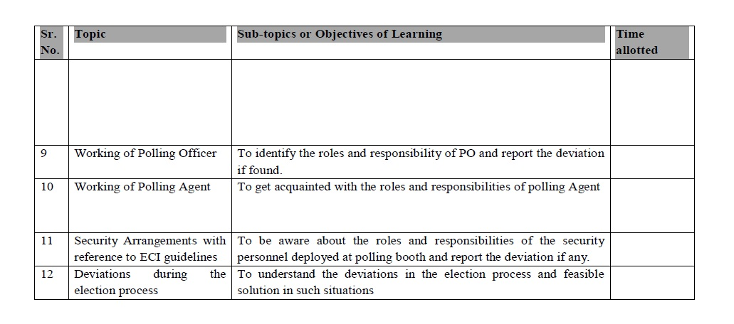
Session Plan for the training of Micro Observers
Job description of Micro Observer

Slide 4
Supervision of the work of Micro-observers
General Observers will supervise the work of Micro-observers and shall be in close touch with them.
Micro- Observers shall report to the Observer.

Slide 5
Work to be done by Micro-observers on poll day
Micro observers should reach the Polling Station at least one hour before the start of poll. They will do the following at the polling station:
  Assess the preparedness at the Polling Station.
  Check the availability of Basic Minimum Facilities (BMF) at the Polling Station and certify, before the start of Polling.
  Watch the mock poll and see that it is carried out as per the instructions of the Commission.
  See that the votes in the CU are cleared after the mock poll and before the start of actual poll and that mock poll certificate is signed by the Presiding Officer.
  During the poll day he should regularly note down the important points for his report in the format given at Annexure.
  lt is made absolutely clear that in no case the Micro observer will act as Presiding Officer or the polling officer. His task is to observe that the election process is being carried out in a free and fair manner and there is no vitiation of Poll.

Slide 6
Work to be done by Micro-observers on poll day
  During the process of observation on the day of the poll, the Micro Observer shall specially observe and note:
    Mock Poll Procedures.
    Presence of Polling Agents and observance of ECI instructions with regards to them.
    The observance of entry pass system and access to Polling Station.
    Proper identification of electors in accordance with ECI guidelines.
    Identification and recording procedures for the Absentee, Shifted and Dead voter's list (ASD list).
    Application of indelible ink.
    Noting down particulars of electors in register Form 17-A including the noting down of the alternate identity documents used for identifying the voter, Secrecy of voting.
    Conduct of polling agents, their complaints, if any.

Slide 7
Work to be done by Micro-observers on poll day
lf the Micro-Observer feels that the poll is being vitiated for any reason, he will immediately bring it to the notice of General observer through any means of communication available to him including mobile phone, police wireless etc.
Report to be submitted by Micro-observer - After the poll process is over, the Micro-observer will submit a report to the General Observer in the format at Annexure.
He shall hand over the report to the General Observer at the collection center in a sealed envelope.
He shall also orally brief the General Observer on anything of importance that had happened during the day.
General Observers will go through the report submitted by Micro-observers and can seek any further clarifications required.

Slide 8
Procedures to be followed on previous day of Election
1 | Election Date | 26-04-2024
2 | Election time | 7am to 5 pm
3 | On previous day of poll | 25-04-2024
A | Polling team will reach Mangaldai College before 6 AM and will decode their respective PS from the decoding center.
B | After decoding the PS, polling team will receive EVM, VVPAT, and all polling materials as per check list along with remuneration. Presiding Officer - Will check Address tag, Pink Paper Seal and will compare with EVM machine no. Will check BU, CU, and VVPAT and their number as well as ballot paper fixed under the screen of BU. Will check the Thumbwheel for its correctness. Will check Mark Copy of the Photo ER, list of contesting candidates and display notices. Will check that the “Candidate Set Section” duly sealed and the pink paper seal is intact. Will check the power of the battery by switching “ON” the switch and thereafter switch “OFF”. Will not try to connect CU, BU, and VVPAT and will not test the VVPAT before mock poll on the day of poll.
C | Will contact respective Sector Officer and Security personnel. Will move to Transport Cell to avail allotted vehicle. And proceed to respective PS as per guidance of Sector officer.
D | Will inspect the PS as per instructions given by ECI and will prepare necessary papers for the day of poll. Will prepare the layout of the PS for the day of poll

Slide 9
Procedures to be followed during Election Day
(During Mock Poll)
4 | On the day of Poll | 26-04-2024
Activity during Mock Poll
A | Will set up the polling station as per the guidelines of ECI. Will display notices specifying the PS outside the polling booth prominently along with all other posters/notices. Will make ready for Mock Poll by connecting EVM and VVPAT (BU → VVPAT → CU / Unlock Paper Roll knob(vertical position) of VVPAT / Switch ON the CU). Will verify the appointment letter of polling agents. Will start Mock Poll as per guideline 90 minutes before the actual hours of commencement of poll. At least 50 votes should be cast during Mock Poll pressing all unmasked blue button including NOTA. Will take out the VVPAT slips from the drop box after completion of Mock Poll, check to the satisfaction of the polling agents, put stamp on the back side of the slips, put the slips in the black envelope provided, put the black envelope in the plastic box, and seal the box with pink paper seal. Do sign as well as obtain signature of polling agents on the envelope.
B | Will fill up Part-I (Mock Poll Certificate) of Presiding Officer’s Report (Annexure-5, page- 100) and obtain signature of polling agents and Micro observer if posted

Slide 10
Procedures to be followed during Election Day
(During Mock Poll)
C | Will clear the CU by pressing the “CLEAR” button.(CRC) and show zero vote in CU by pressing Total button to all polling agents and put signature of presiding officer in the report (part I) Will seal the result section of CU by using Green Paper Seal, Address Tag, and Special Tag.(Presiding officer and polling agents to note down the Sl. No. of Green Paper Seal). Will put signature of presiding officer and polling agents on the Green Paper seal just below the Sl. No. as well as on the back side of Special Tag. Presiding Officer will note down the sl. No. of CU on the front side of the Special tag before sealing of the CU. Will seal the VVPAT drop box by using Address Tag after ensuring removal of all mock poll slips.
D | Will place BU & VVPAT in the voting compartment (VVPAT on left side of BU), and connect with CU. Switch on the CU at the time fixed by ECI.
E | Will allow polling agents to note down the Sl. No. of the BU, CU, and VVPAT.
F | Will make declaration at the commencement of the poll.(Annexure 6(part I), page- 106) ) and will also obtain signature of polling agents along with own signature. Will read out the provisions of the section 128 of the R. P. Act 1951 to maintain secrecy of voting.

Slide 11
Procedures to be followed during Election Day
(During Actual Poll)
G | Will ensure that polling starts sharp at the appointed time(7:00am) Just before the first voter signs in Form 17A (Register of voter), the Polling Officer 1 shall check with the Presiding Officer and record in INK in Form 17A that “Total in the Control Unit checked and found to be Zero”,
H | Will keep vigil on the whole polling process, on polling officers as well as on the polling agents for smooth conduct of voting.
I | Will maintain Polling Agents/Relieving Agents movement Sheet (Annexure-11, page-124))
J | Will issue Entry Pass (Annesure-12, page-page-125))
K | Will maintain records pertaining to Annexure – 13, 14, 15, 16, 18, 19, and 20 as and when necessary as per guideline of ECI.
L | Will process as per guideline pertaining to Identification of Electors (49H), Facilities for Public servants on election duty (49I), Challenging of Identity (49J), Electors not allowed to cast vote (49M), Complain about particulars printed on paper slip (49MA), Voting of Blind or Infirm Electors (49N), Electors decidi ng not to vote (49O), Tender votes (49P) etc. Clear instructions are given in the Handbook of Presiding Officer for reference.
M | Will maintain 2 hourly report.
N | Will have periodic checking of register of voters with the votes casted in the CU to avoid mismatching.
O | Will distribute pre-numbered slips to the voters starting from the last person in queue at the prescribed time for end of poll to ensure that no one can cast vote who have come after the prescribed time.
P | Will close the poll by pressing Close button of CU after last voter cast his vote or at the prescribed closing time.
Q | Will make a declaration in Part III (Annexure-6, page- 110) at the end of poll by signing and obtaining signature of polling agents.

Slide 12
Procedures to be followed during Election Day
(During Actual Poll)
R | Will prepare “accounts of votes recorded” in Form 17C and copies thereof will be furnished to the Polling agents present. A copy of Form 17C put inside an envelope should be attached on the body of the CU box carefully before handing over to material receipt center.
S | Will switch “OFF” the CU. The BU, CU, and VVPAT will be disconnected. Power pack of the VVPAT will be removed. CU, BU, and VVPAT will be put back in their respective carrying cases.
T | Will seal above mentioned carrying cases at both sides with the help of thread of Address Tag sealed properly bearing Presiding Officer’s signature, date and seal as well as signature of Polling Agents if they desire to put signature.
U | Will note the names of the Polling Agents/Contesting candidate who have put their signature after sealing of voting machine will be noted in Part IV (Annexure-6, page 111).
V | Will prepare Presiding Officer’s Diary (Annexure-7, page-112) properly.
W | Fill up the format of “polling station data sheet for scrutiny decision” carefully (to be provided with materials) Will fill up remaining part of declarations to be done at the end of poll.
X | Will fill up (Annexure-22, page-135) and seal all election papers by signing and obtaining signature of Polling Agents as per guidelines.
Y | Will ensure that all six large packets contain all relevant small packets as per guideline before sealing. (Please refer para 7.5, page no. 66,67,68 of handbook)
Z | Will deposit all items of election records and materials including EVM and VVPAT to Official-in charge of the Receiving Center and will obtain a receipt. After successful submission the Presiding Officer will be relieved. (Hand over the part IV and V of Presiding Officer report (Annexure-V, page-104 & 105) even if nil report to the concerned Sector Officer)

Slide 13
Replacement of EVM/VVPAT
If any unit goes wrong before actual poll or mock poll, then only the defective unit will be replaced with a new unit by returning the defective unit to Sector Officer. Presiding Officer’s Report Part-I and Part-IV (Annexure 5, page- 100 & 104) will be prepared.
If BU or CU or both BU & CU goes wrong during actual poll, then complete set of BU, CU, & VVPAT will be replaced with a new set. Mock Poll will be done by casting 1 vote for all contesting candidates including NOTA. Presiding Officer’s Report Part-I and Part-V (Annexure 5, page- 100 & 105) will be prepared. Old units will be sealed in carrying cases. Power pack of defective VVPAT will be removed before sealing.
If only VVPAT goes wrong during actual poll, the defective VVPAT will be replaced. No Mock Poll is required. Presiding Officer’s Report Part-V (Annexure 5, page-105) will be prepared. Power pack of defective VVPAT will be removed before sealing. If only battery of VVPAT goes wrong, then the battery will be replaced. No mock poll.
If battery of CU goes wrong during actual poll, then the battery will be replaced. No mock poll. Presiding Officer’s Report Part-II (Annexure 5, page-102) will be prepared.

Slide 14
Important note
One extra copy of Form-17C and Presiding Officer report Mock poll certificate to be submitted in the material receipt counter.
Hand over carefully the filled up format of “polling station data sheet for scrutiny decision” at the material receipt center
Different colour code has been incorporated for easing out trouble in searching various cells of respective LACs during material issue and receipt days as follows:
  Sipajhar LAC- Yellow
  Mangaldai LAC- Light Blue
  Dalgaon LAC- Pink

Slide 15
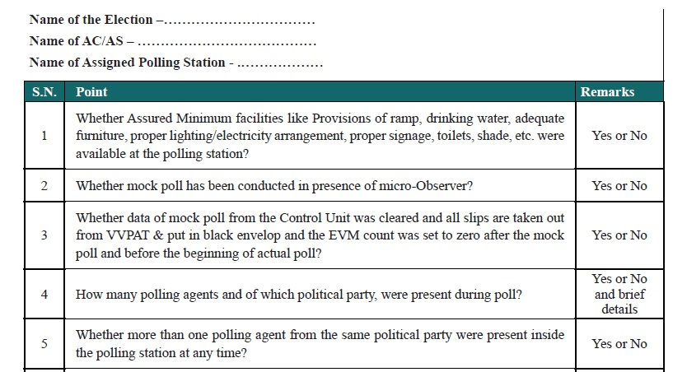
ANNEXURE-28
MICRO OBSERVER REPORT ON POLL DAY

Slide 16
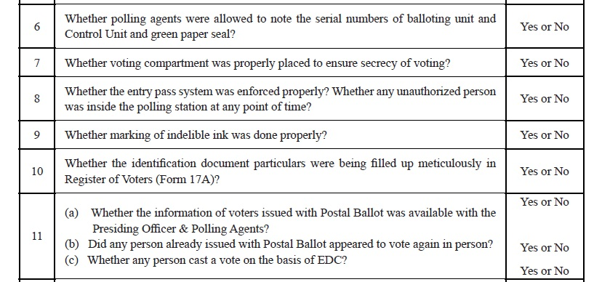
ANNEXURE-28
MICRO OBSERVER REPORT ON POLL DAY

Slide 17
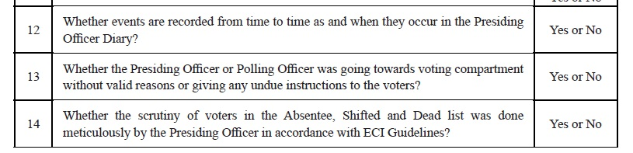
ANNEXURE-28
MICRO OBSERVER REPORT ON POLL DAY

Slide 18
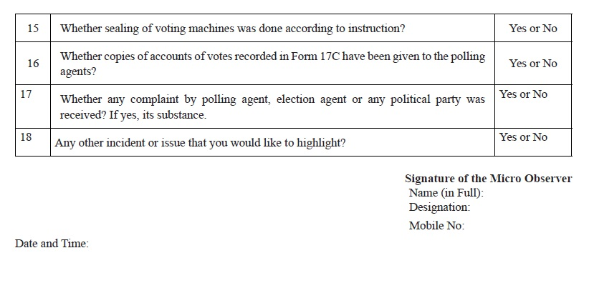
ANNEXURE-28
MICRO OBSERVER REPORT ON POLL DAY

Slide 19
Video on..
Mock poll
Training on EVM & VVPAT
Poll procedure

Slide 20
Thank you..

